Slide 1
Deep Recurrent Double Q-Learning in Atari Environment
Luca Corvitto - 1835668
Reinforcement Learning
Sapienza University of Rome

Slide 2
Introduction

Slide 3
Q-Learning
RL algorithm that will find the best course of action, given the current state of the agent.
Model-free
Off-Policy
Learning Rate
Discount Rate
New Q value for the state and action
Maximum expected future reward
Current Q values
Current Q values
Reward for taking an action in a state
Deep Recurrent Double Q-Learning in Atari Environment – Luca Corvitto

Slide 4
Double Q-Learning
Q-Learning suffers of the so-called Maximization Bias. To solve it we could learn two independent estimates:
One could be used to determine maximizing action
Other could be used to estimate value
Only one estimate is updated on each episode
Memory requirement is doubled
agent
Target agent
Deep Recurrent Double Q-Learning in Atari Environment – Luca Corvitto

Slide 5
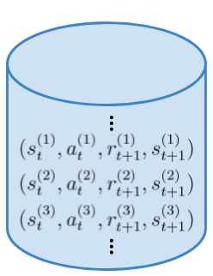
Experience Replay Buffer
Tool used in RL to enhance performance:
Stores previous transitions experienced by an agent
Transitions are used later in time for training
Efficient use of previous experience
Better convergence with function approximators
Deep Recurrent Double Q-Learning in Atari Environment – Luca Corvitto

Slide 6
Deep Q-Learning
Instead of VFA, DQN uses Deep Neural Networks:
Use distributed representations instead of local representations
Universal function approximators
Can potentially need exponentially less nodes/parameters to represent the same function
Can learn the parameters using stochastic gradient descent
Deep Recurrent Double Q-Learning in Atari Environment – Luca Corvitto
Notes:
(like Kernels in SVMs) (compared to a shallow net)

Slide 7
Deep Q-Learning approaches in Atari Environment

Slide 8
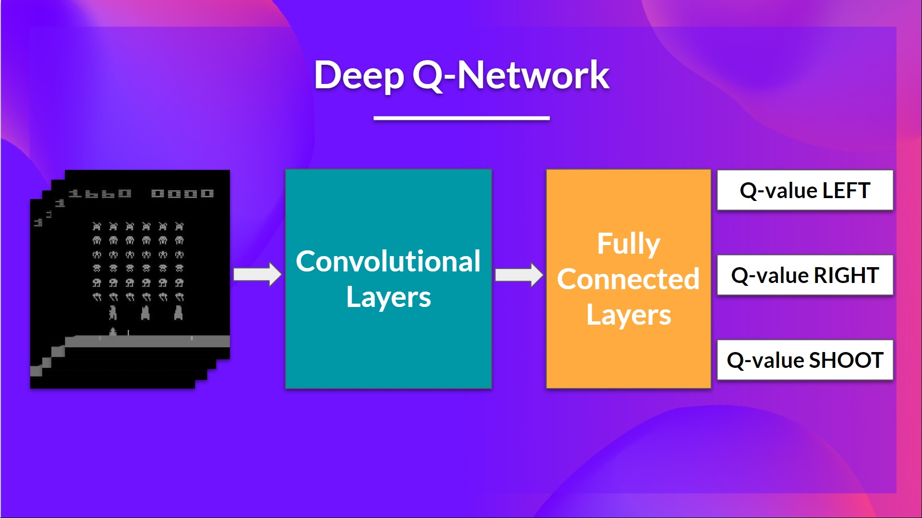
Convolutional Neural Networks
For Atari games each state is represented by an image.
CNNs extract features from the image
Apply convolution operations to process pixels information
Adding dense layers at the end allow to obtain in output the Q-values
Deep Recurrent Double Q-Learning in Atari Environment – Luca Corvitto

Slide 9
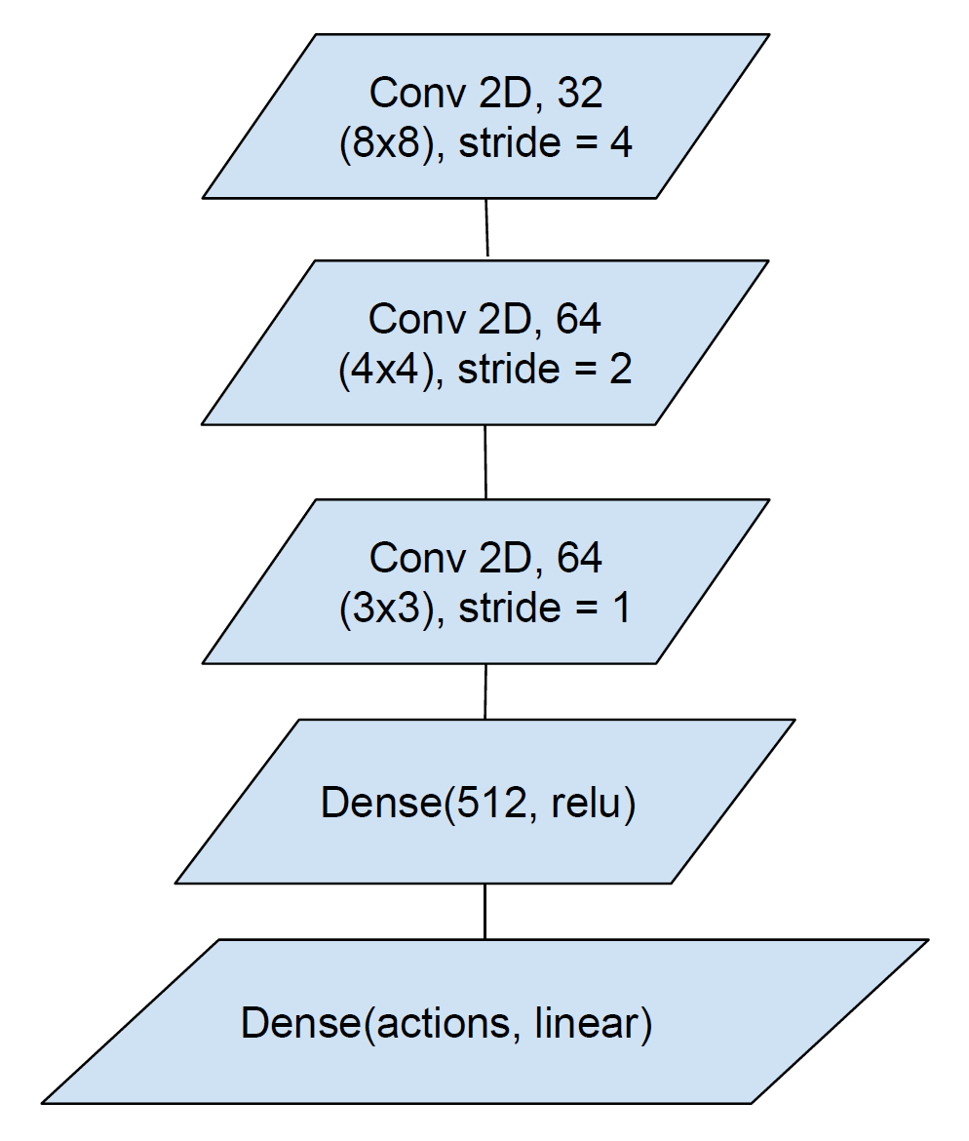
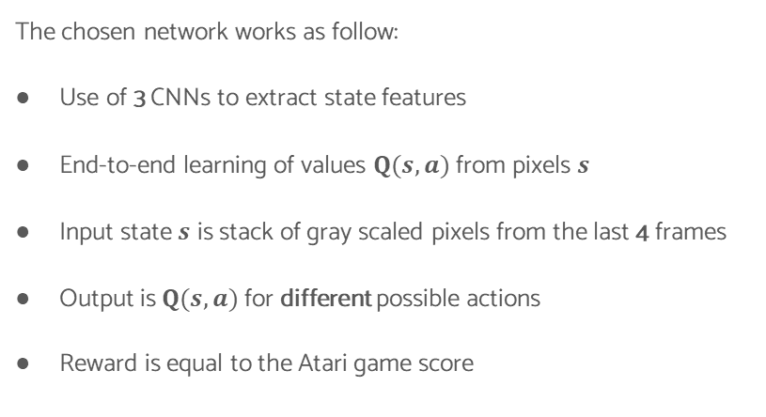
DQN & DDQN in Atari Environment
The chosen network works as follow:
Use of 3 CNNs to extract state features
End-to-end learning of values $Q(s,a)$ from pixels $s$
Input state $s$ is stack of gray scaled pixels from the last 4 frames
Output is $Q(s,a)$ for different possible actions
Reward is equal to the Atari game score
Moreno, Felipe A.. (2019). Performing Deep Recurrent Double Q-Learning for Atari Games.
Deep Recurrent Double Q-Learning in Atari Environment – Luca Corvitto

Slide 10
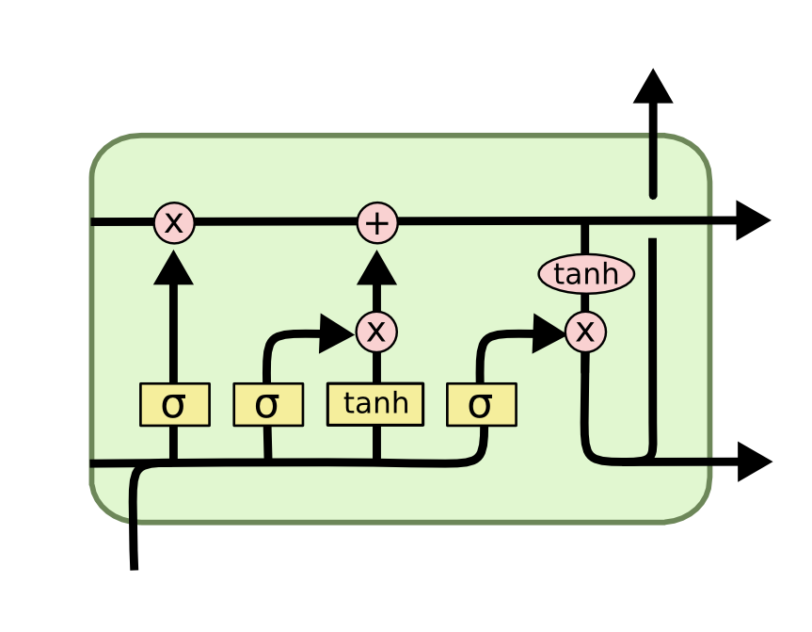
Long Short-Term Memory
LSTM is a RNN capable of learning long-term dependencies:
Controls the flow of information through the network
Passes information across different time steps
Effective for processing sequential data
Deep Recurrent Double Q-Learning in Atari Environment – Luca Corvitto

Slide 11
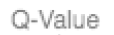
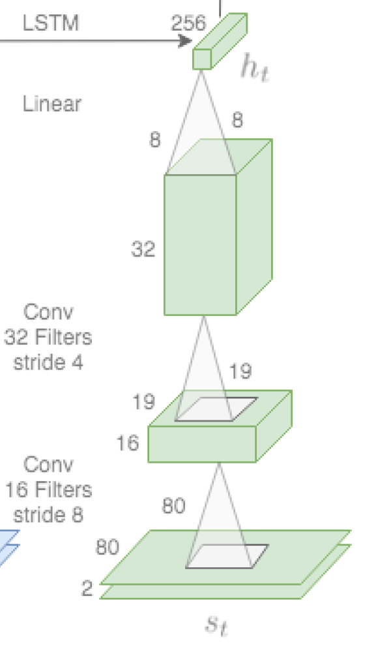
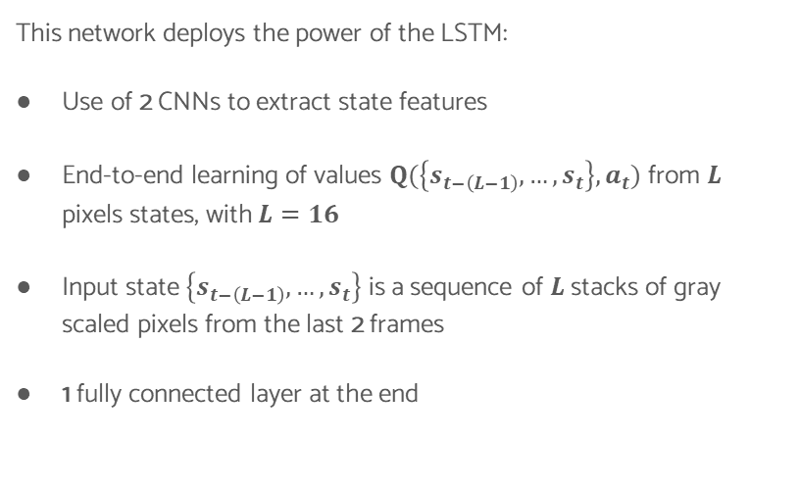
DRQN in Atari Environment
This network deploys the power of the LSTM:
Use of 2 CNNs to extract state features
End-to-end learning of values $Q(\left\{s_{t−\left(L−1\right)},…,s_{t}\right\},a_{t})$ from $L$ pixels states, with $L=16$
Input state $\left\{s_{t−\left(L−1\right)},…,s_{t}\right\}$ is a sequence of $L$stacks of gray scaled pixels from the last 2 frames
1 fully connected layer at the end
Clare Chen, Vincent Ying, Dillon Laird, ”Deep Q-Learning with Recurrent Neural Networks”.
Deep Recurrent Double Q-Learning in Atari Environment – Luca Corvitto

Slide 12
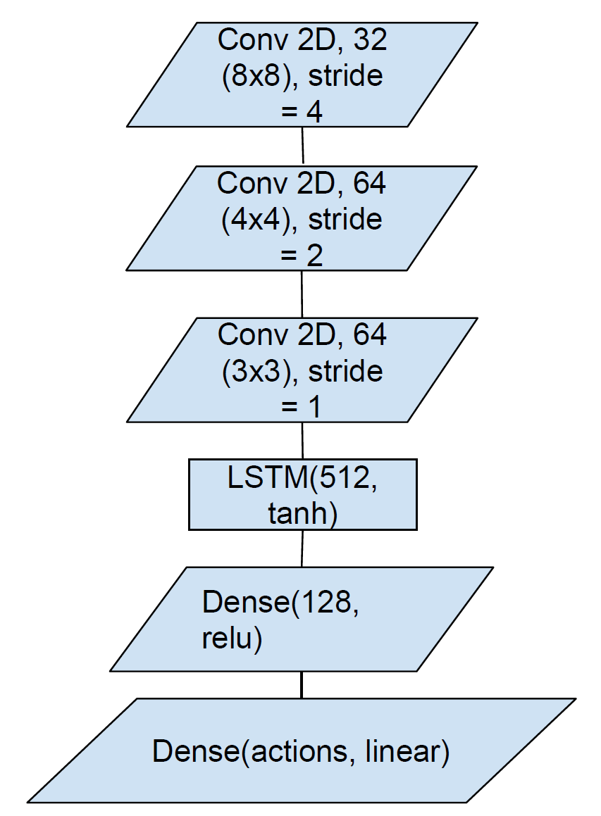
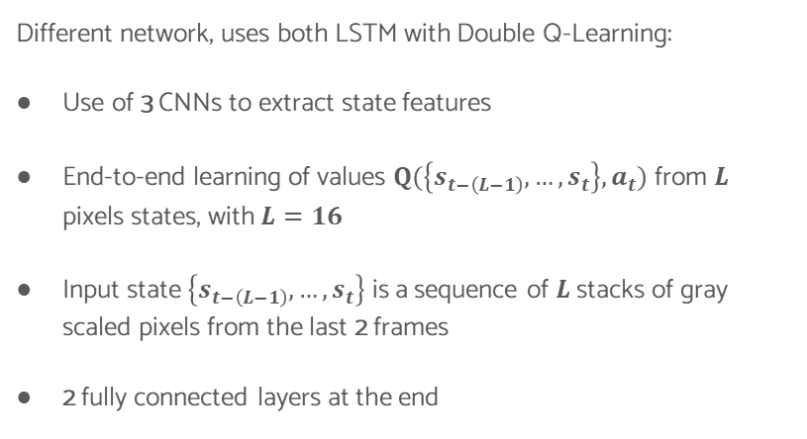
DRDQN in Atari Environment
Different network, uses both LSTM with Double Q-Learning:
Use of 3 CNNs to extract state features
End-to-end learning of values $Q(\left\{s_{t−\left(L−1\right)},…,s_{t}\right\},a_{t})$ from $L$ pixels states, with $L=16$
Input state $\left\{s_{t−\left(L−1\right)},…,s_{t}\right\}$ is a sequence of $L$stacks of gray scaled pixels from the last 2 frames
2 fully connected layers at the end
Deep Recurrent Double Q-Learning in Atari Environment – Luca Corvitto

Slide 13
Simulations & Performances

Slide 14
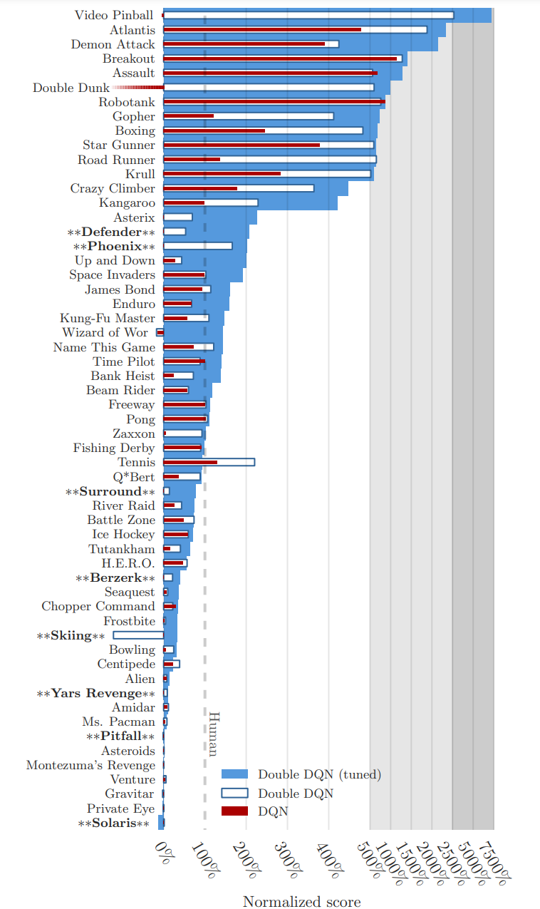
Atari Performance
Different Atari games have different learning behaviors: [3]
DDQN is, in general, better than DQN
In some games DDQN is at the same level or worse than DQN
Van Hasselt, H., Guez, A., & Silver, D. (2016). Deep Reinforcement Learning with Double Q-Learning. Proceedings of the AAAI Conference on Artificial Intelligence, 30(1).
Deep Recurrent Double Q-Learning in Atari Environment – Luca Corvitto

Slide 15
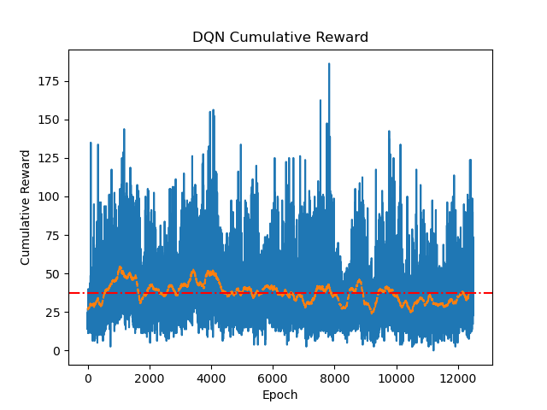
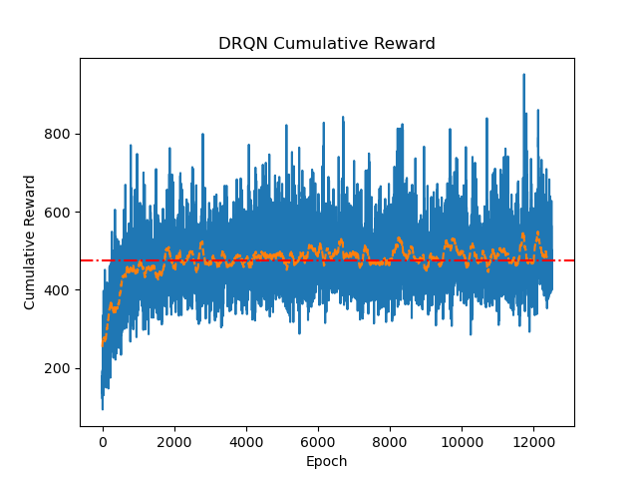
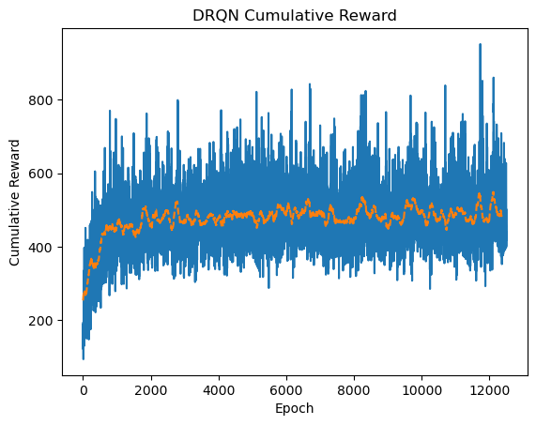
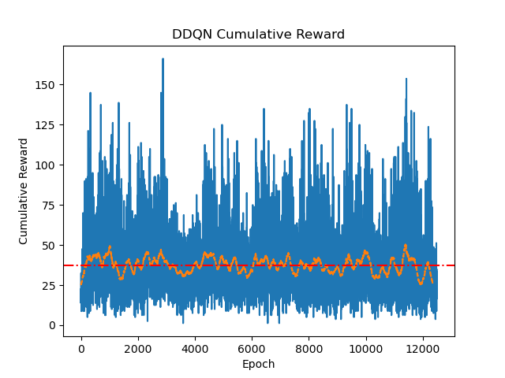
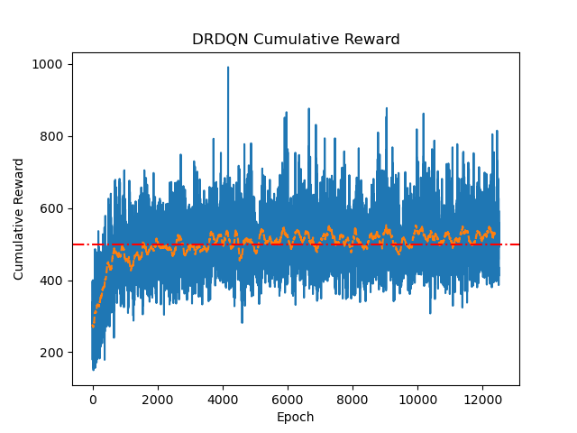
Space Invaders Cumulative Reward
According to [1]:
DQN and DDQN trends are similar
Analyzing the results:
Adding a LSTM enhances the performances
This can be caused also by the larger number of frames processed at each step by the LSTM versions
Deep Recurrent Double Q-Learning in Atari Environment – Luca Corvitto

Slide 16
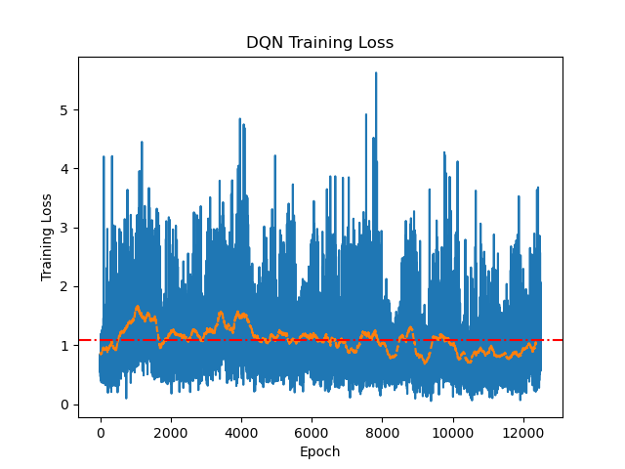
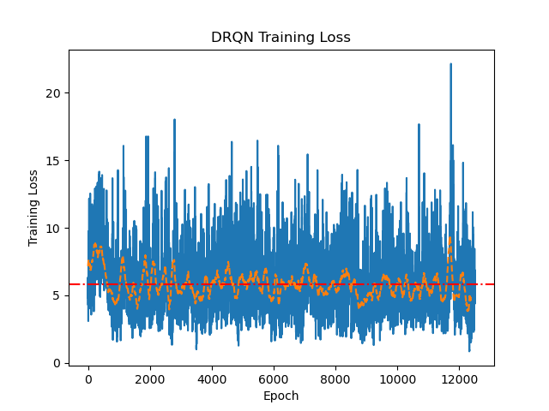
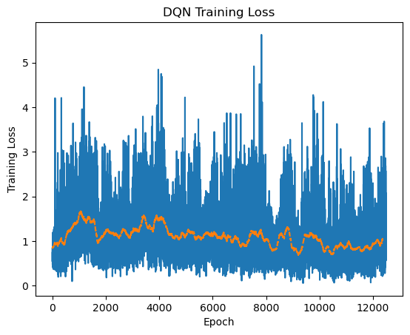
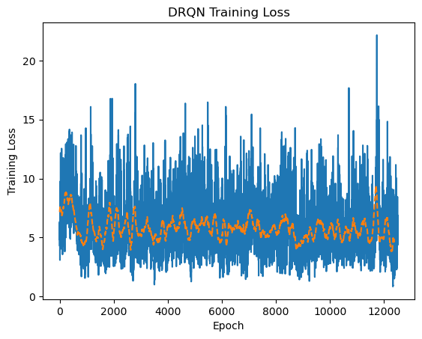
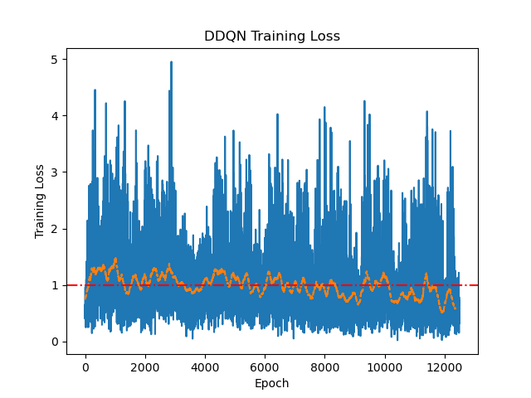
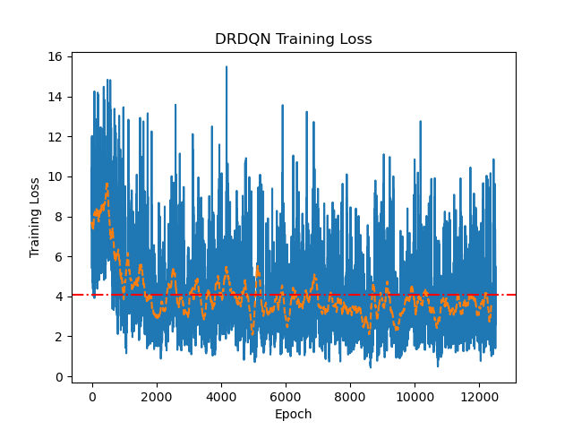
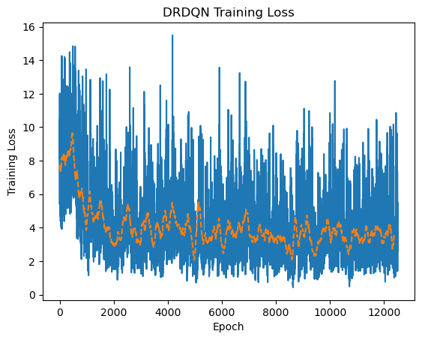
Space Invaders Training Loss
The same stands for the training loss:
DQN and DDQN trends are similar
DRQN and DRDQN losses are higher, but they have a decreasing behavior
Losses and rewards are not strictly connected
In this case it can be due to the different number of frame processed
Deep Recurrent Double Q-Learning in Atari Environment – Luca Corvitto

Slide 17
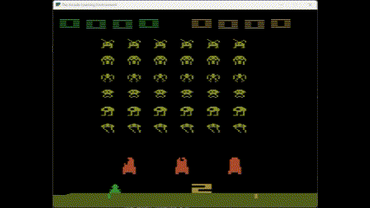
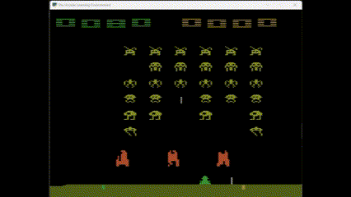
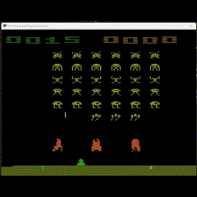
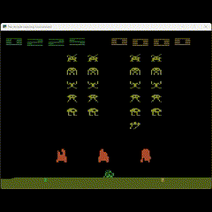
Space Invaders Performance
 | DQN | DDQN | DRQN | DRDQN
Mean reward | 82 | 135 | 298 | 358
DQN
DDQN
DRQN
DRDQN
Deep Recurrent Double Q-Learning in Atari Environment – Luca Corvitto

Slide 18
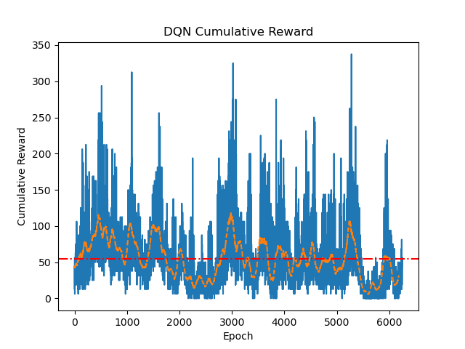
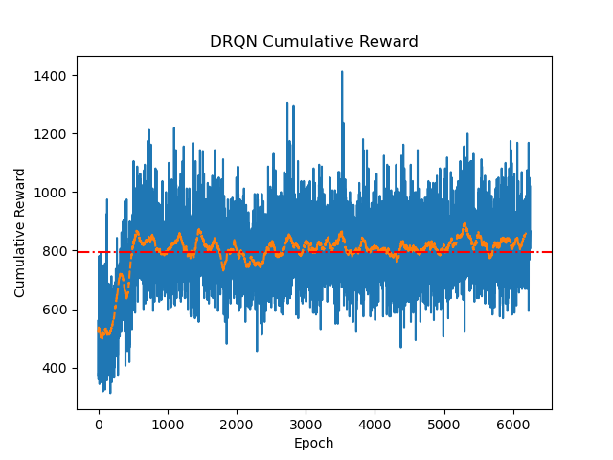
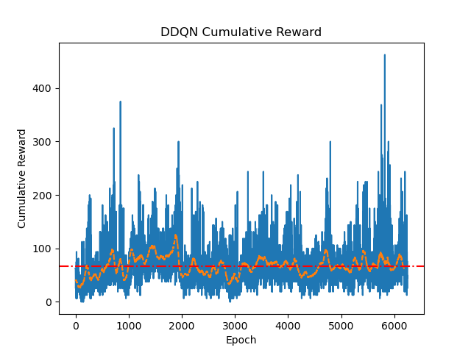
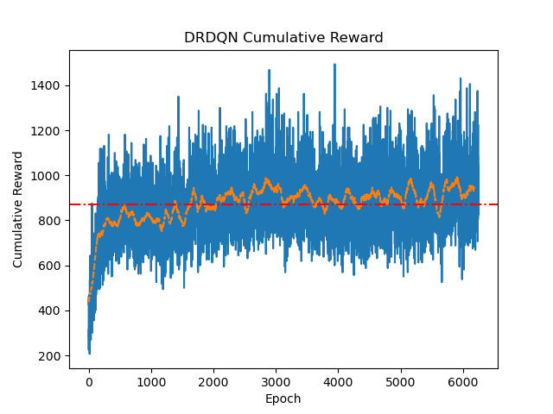
Q*bert Cumulative Reward
According to [1]:
DDQN is better than DQN
Analyzing the results:
Adding a LSTM enhances the performances
Double Q-Learning networks rewards have a higher increase than in Space Invaders
Deep Recurrent Double Q-Learning in Atari Environment – Luca Corvitto

Slide 19
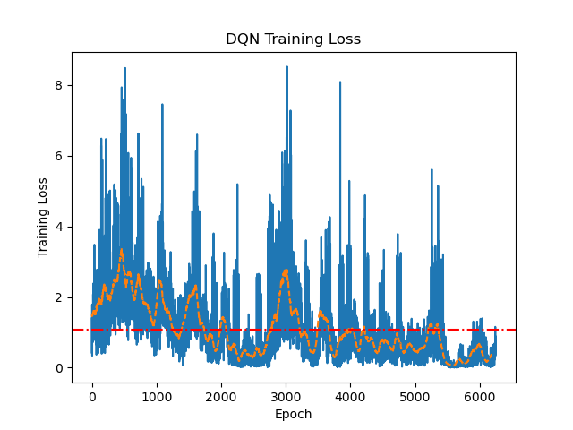
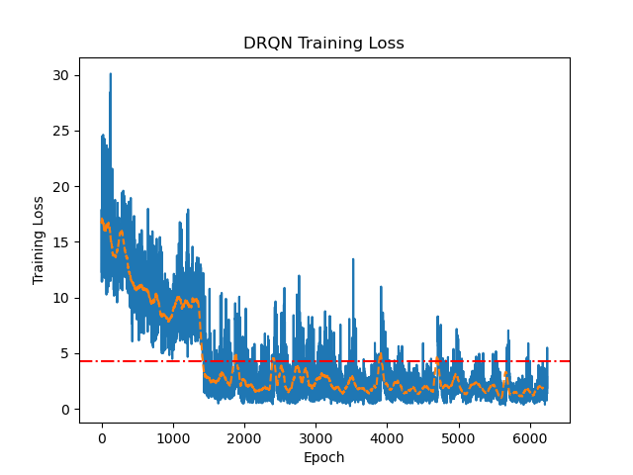
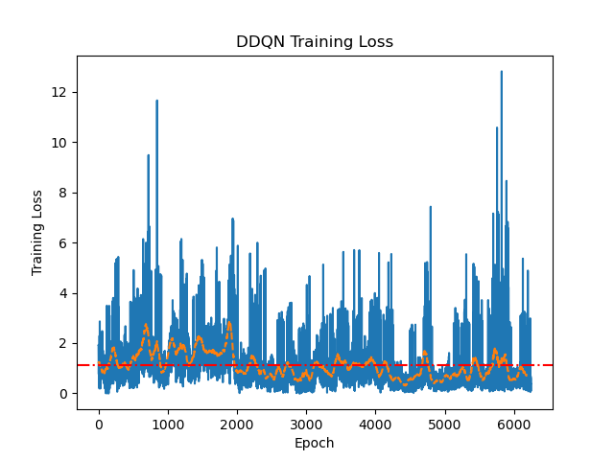
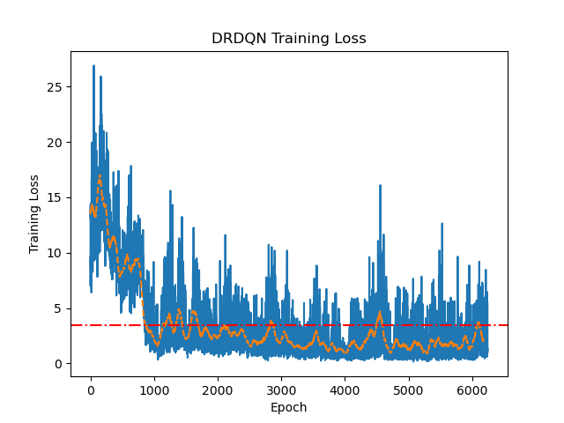
Q*bert Training Loss
Meanwhile, for the training loss:
DDQN loss is more stable
DRQN and DRDQN losses are higher, but they have a decreasing behavior
Losses and rewards are not strictly connected
In this case it can be due to the different number of frame processed
Deep Recurrent Double Q-Learning in Atari Environment – Luca Corvitto
Notes:
Higher stability due to the use of the target network

Slide 20
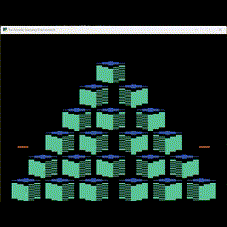
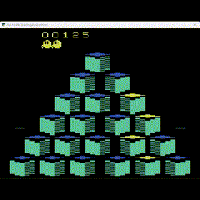
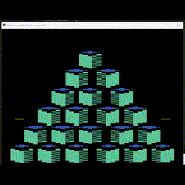
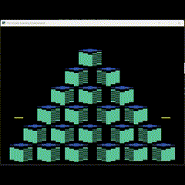
Q*bert Performance
 | DQN | DDQN | DRQN | DRDQN
Mean reward | 121 | 285 | 253 | 312
DQN
DDQN
DRQN
DRDQN
Deep Recurrent Double Q-Learning in Atari Environment – Luca Corvitto

Slide 21
Conclusion

Slide 22


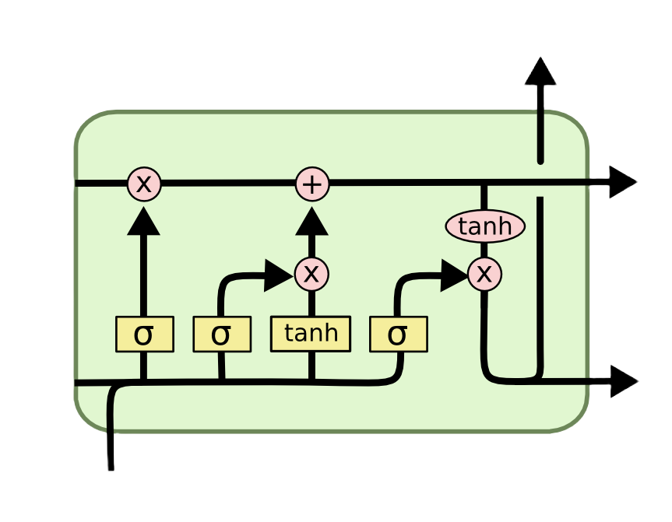

Conclusion
Deep Q-Learning is a powerful tool to learn most of Atari games at human-level or above
Q-Learning variations’ power depends on the game on which are applied
Using Recurrent Neural Networks, like LSTM, with Q-Learning can enhance the performances of simple neural network exploiting the ability to pass information through different time steps
Deep Recurrent Double Q-Learning in Atari Environment – Luca Corvitto

Slide 23
References
Papers:
[1]: Moreno, Felipe A.. (2019). Performing Deep Recurrent Double Q-Learning for Atari Games. 1-4. 10.1109/LA-CCI47412.2019.9036763.
[2]: Clare Chen, Vincent Ying, Dillon Laird, ”Deep Q-Learning with Recurrent Neural Networks”.
[3]: Van Hasselt, H., Guez, A., & Silver, D. (2016). Deep Reinforcement Learning with Double Q-Learning. Proceedings of the AAAI Conference on Artificial Intelligence, 30(1).
Slides:
https://github.com/pietro-nardelli/sapienza-ppt-template [Attribution-NonCommercial-ShareAlike 4.0 International (CC BY-NC-SA 4.0)]
Deep Recurrent Double Q-Learning in Atari Environment – Luca Corvitto

Slide 24
Thank you for the attention!

